Slide 1
Using Augmented Reality with Angular
TJ VanToll (@tjvantoll)

Slide 2


Slide 3

13-year-old me

Slide 4
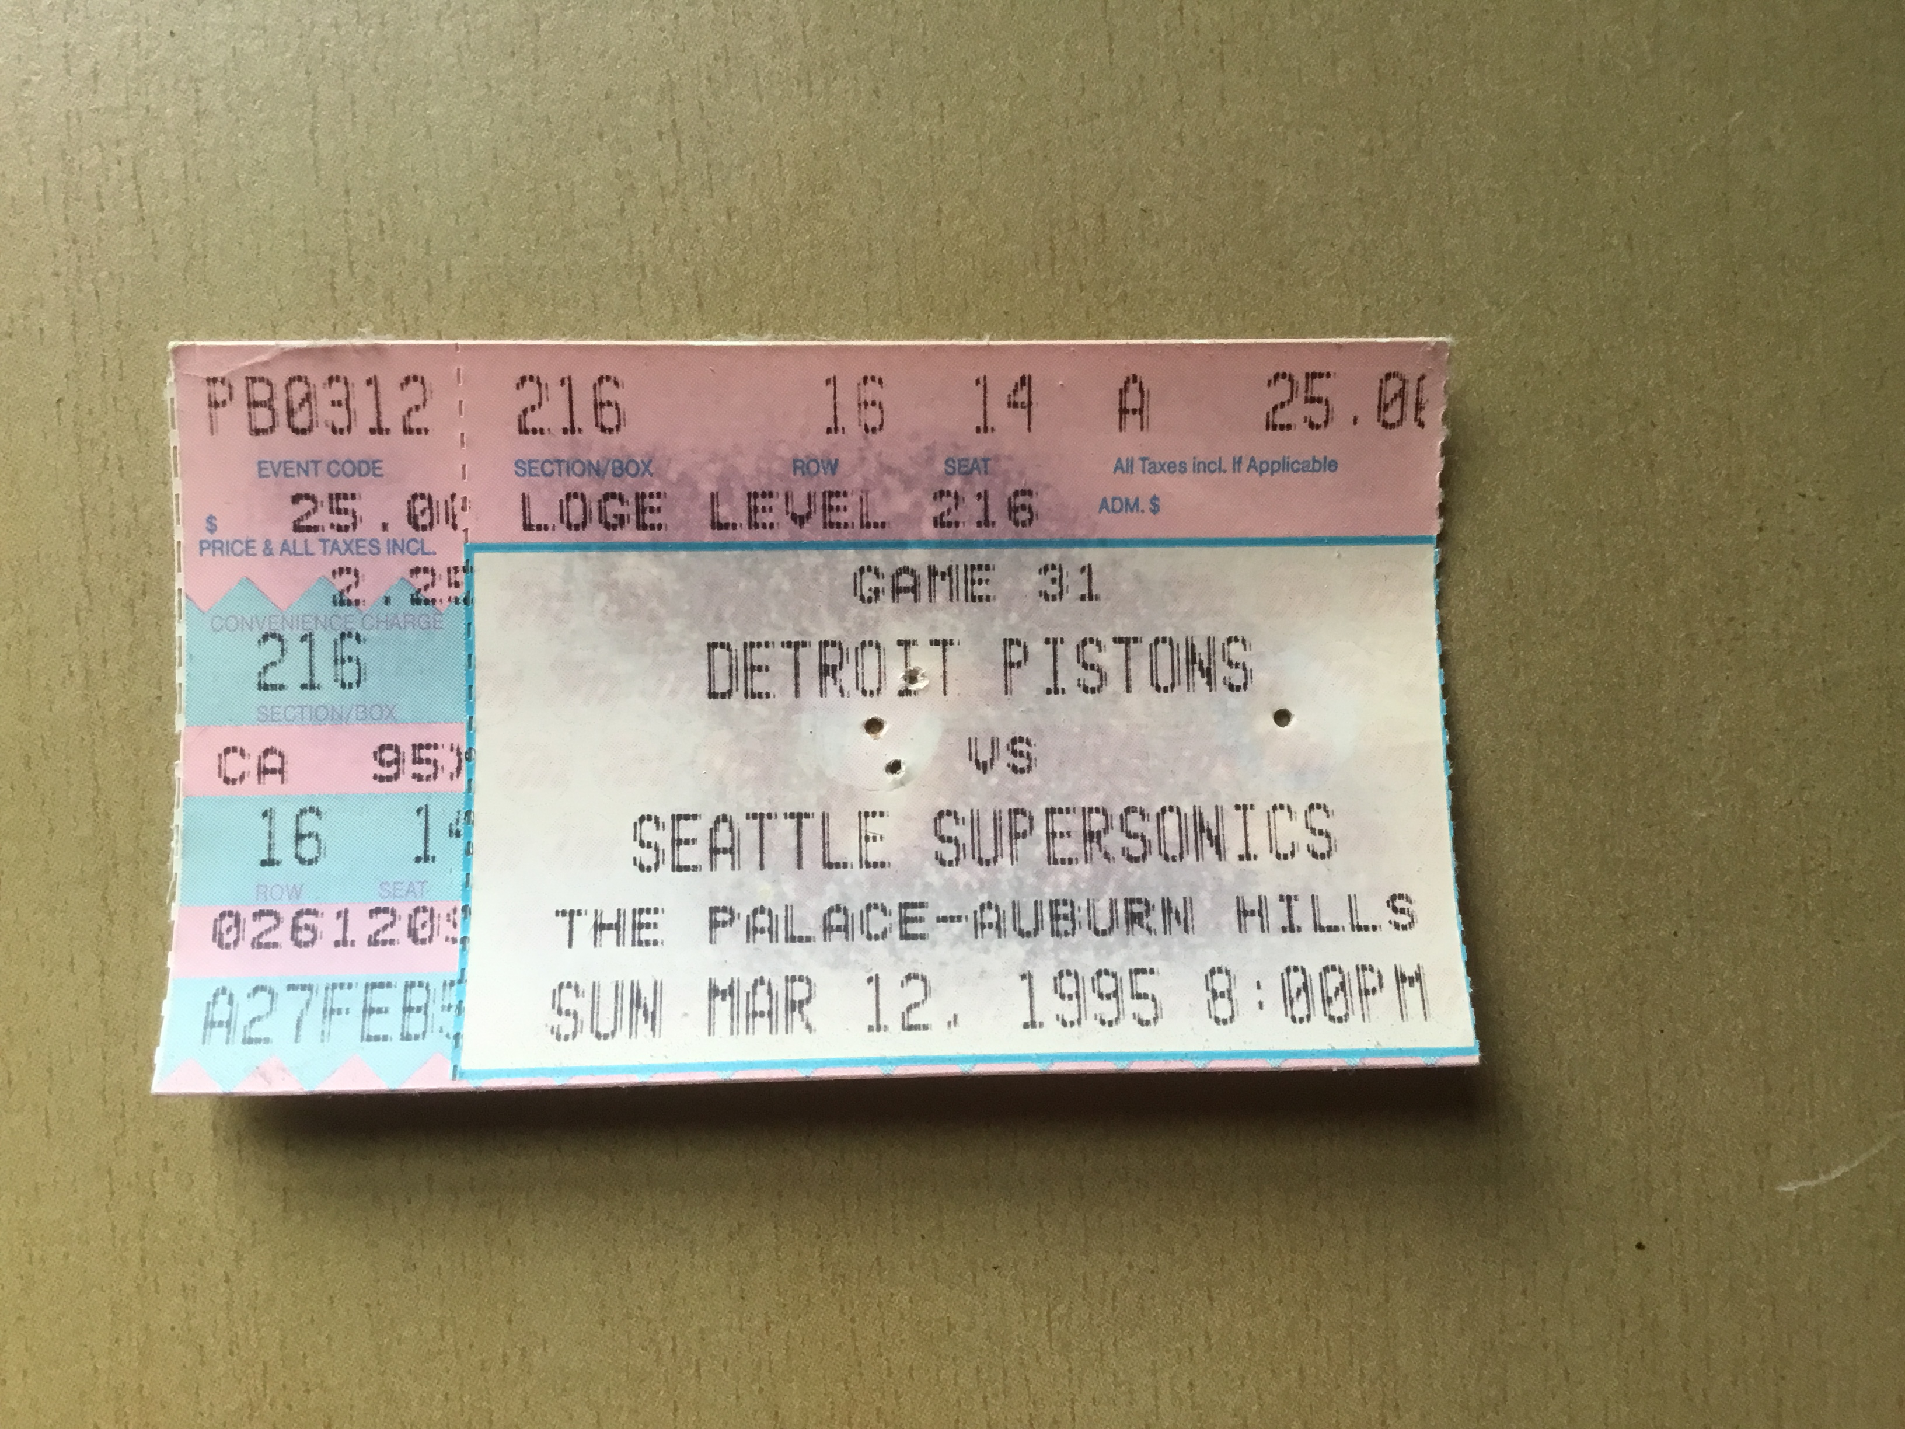

Slide 5
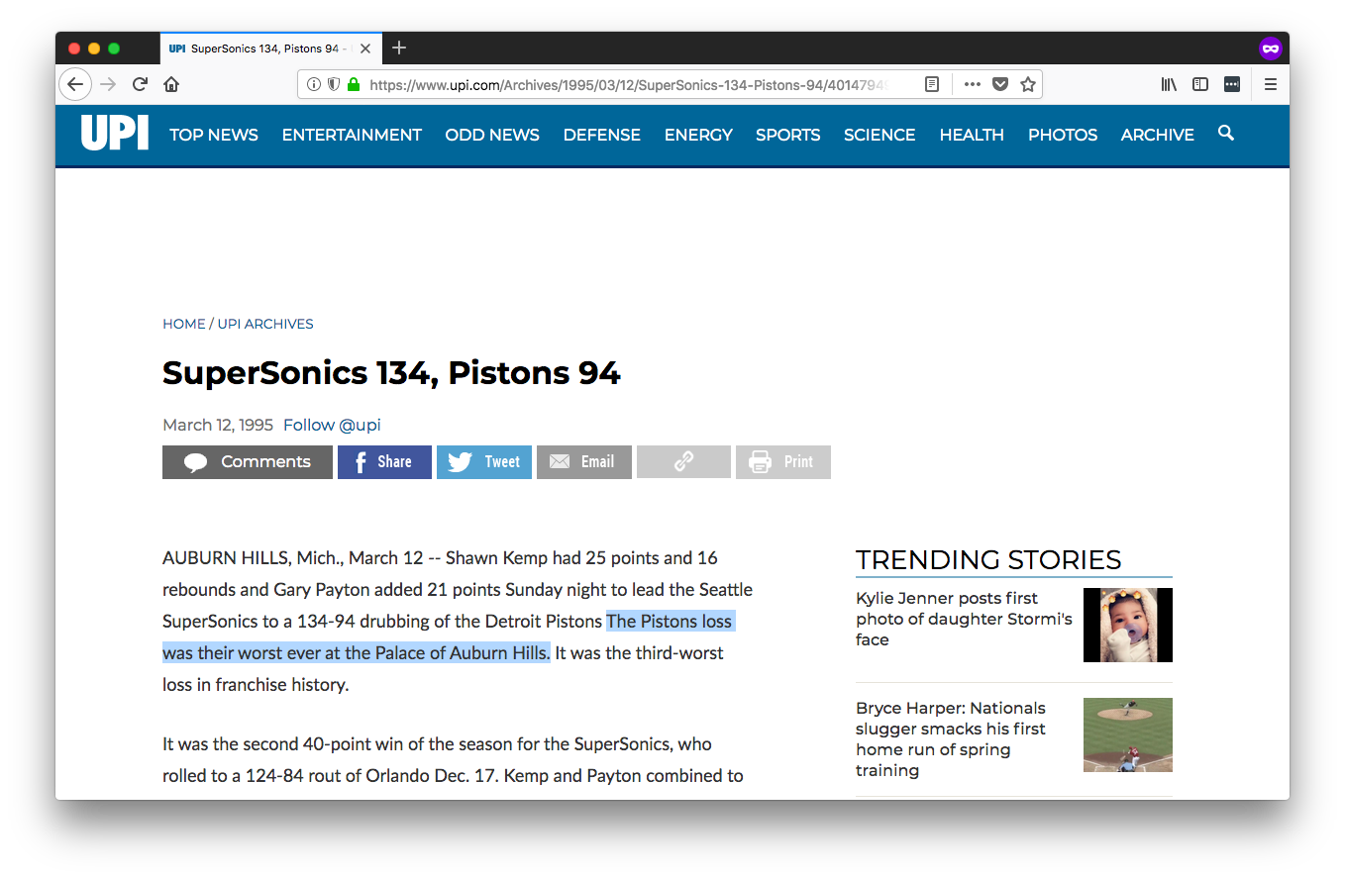
😮

Slide 6
Augmented Reality

Slide 7
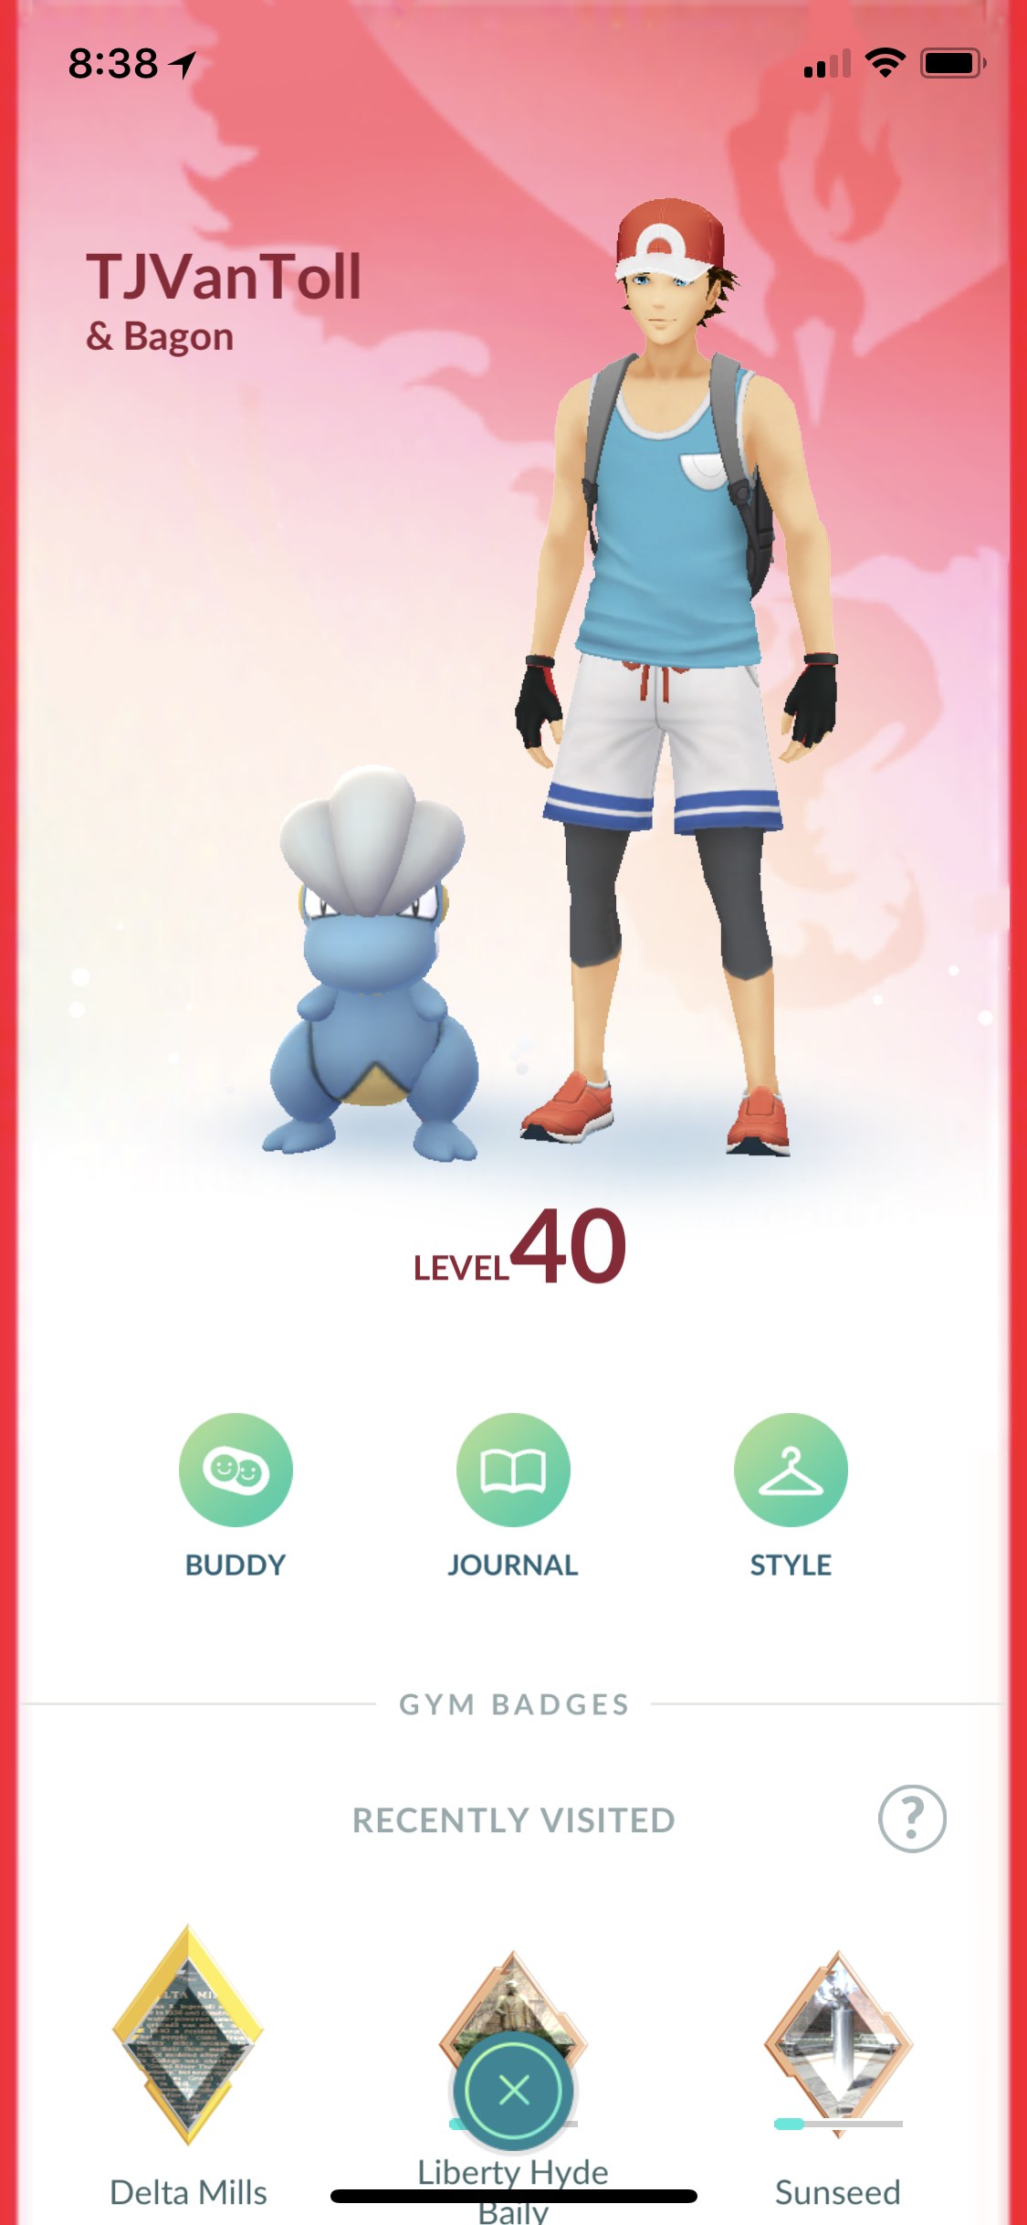

Slide 8

TJ VanToll ⚡️
Principal Developer Advocate
@tjvantoll

Slide 9


Slide 10
Agenda
Brief history of AR
AR today
Building AR apps w/JS

Slide 11
Augmented Reality (AR) is the integration of digital information with the user’s environment in real time.

Slide 12
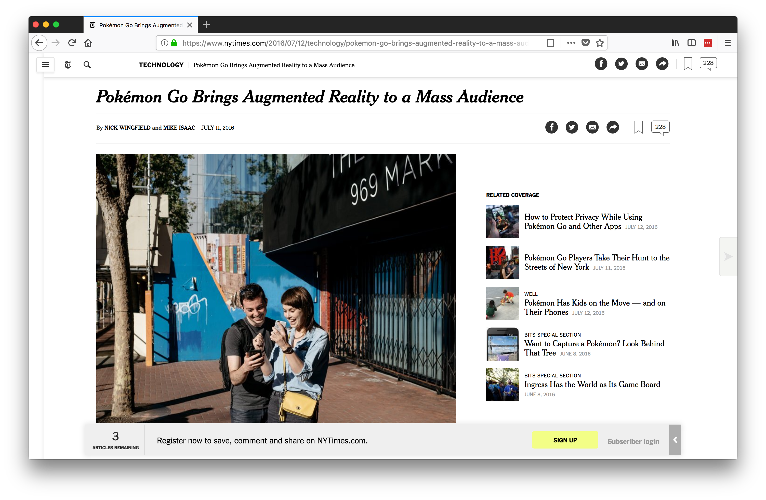
Notes:
1974 Cleveland Indians

Slide 13
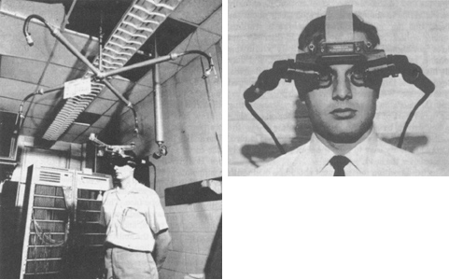
Source: https://www.wareable.com/ar/everything-you-need-to-know-about-augmented-reality
Notes:
Ivan Sutherland, 1968
Had to be suspended from the ceiling

Slide 14

Notes:
Fox acquired rights to the NHL in 1994
Used for two NHL seasons (96–97, 97–98)

Slide 15
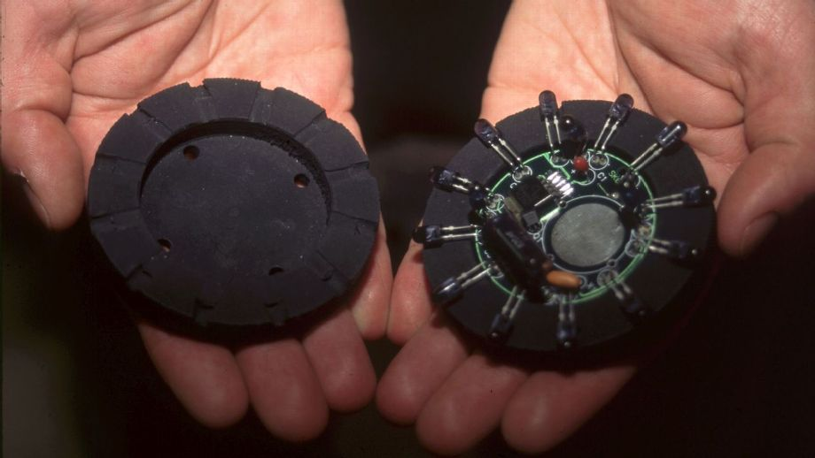
Image from http://www.espn.com/nhl/story/_/id/21080555/nhl-bring-back-infamous-glow-puck
Notes:
used infrared technology to follow LED lights that were imbedded inside the puck. They pulsed 30 times per second as modified cameras picked up the signal
the pucks were not re-usable, and only had a battery life of around 18 minutes

Slide 16

Available on Amazon at https://www.amazon.com/Glow-Pucks-10-Cent-Beer-History/dp/1589793080
Notes:
1974 Cleveland Indians

Slide 17
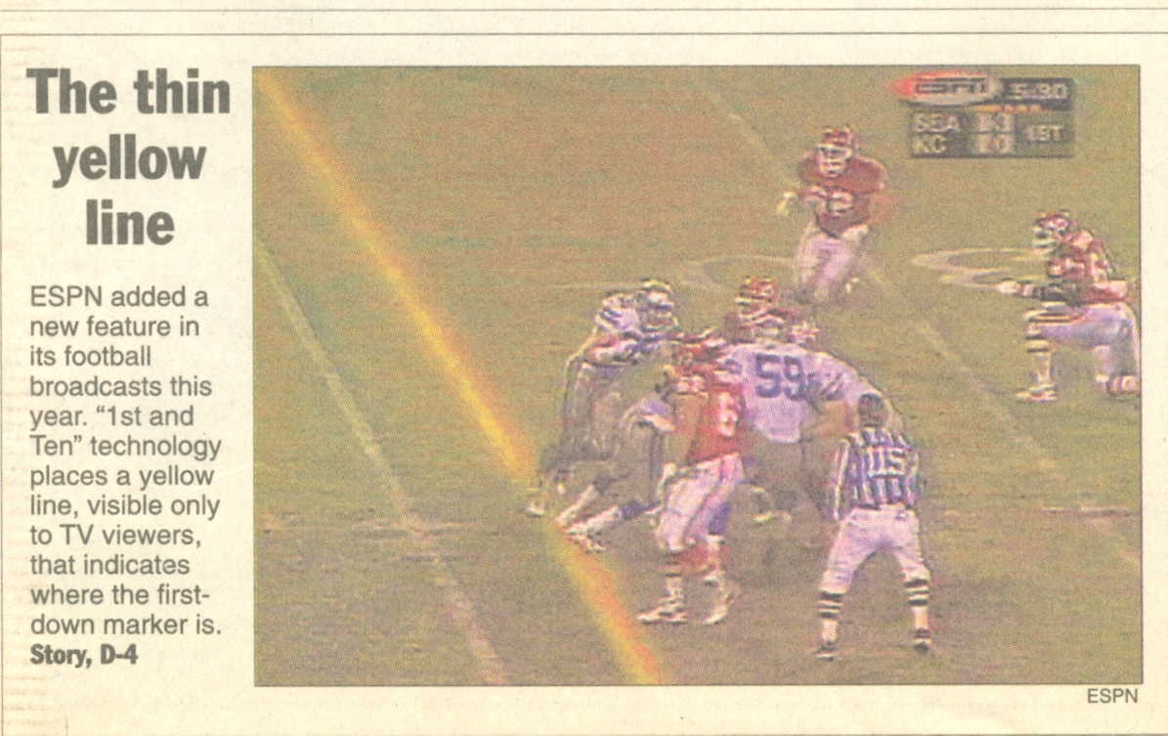
Notes:
1998

Slide 18
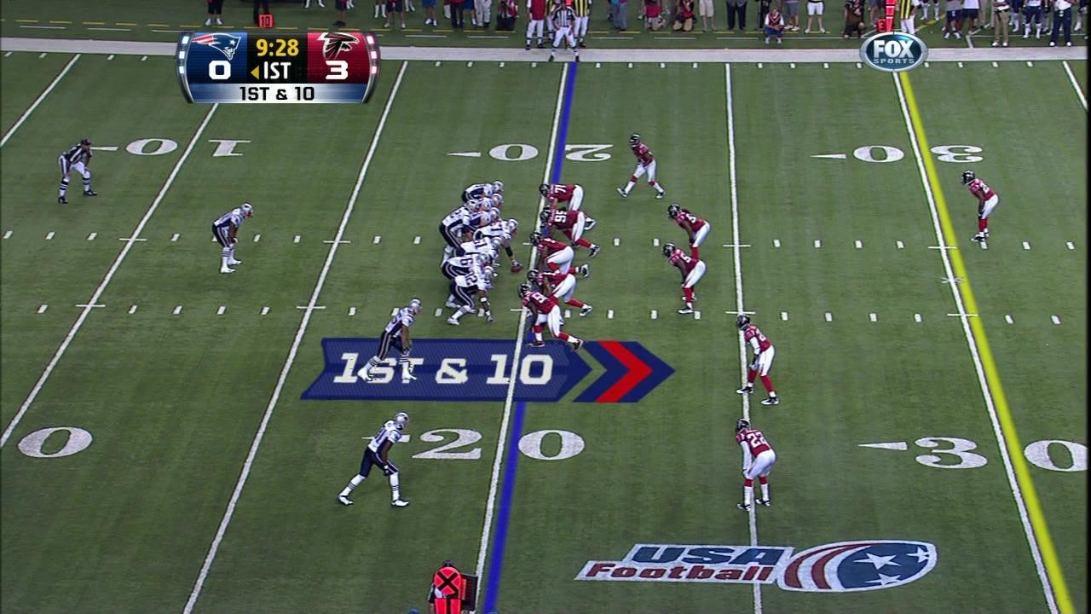
Image from https://gobraithwaite.com/creative-marketing-saved-nfls-yellow-first-line/

Slide 19
“It probably cost the broadcaster $25,000-$30,000 for a weekend back then.
We had to roll out an entire truck to make it work for games in the early days. It was five racks of equipment, a lot of engineers, a traveling circus.”
Source: http://mashable.com/2013/09/25/yellow-first-down-line/

Slide 20
“Now it's basically one computer”

Slide 21
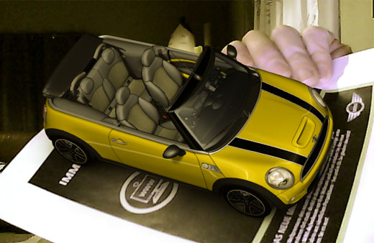
Source: https://technabob.com/blog/2008/12/17/mini-augmented-reality-ads-hit-newstands/
Notes:
2008 BMW first commercial application
Used computer webcam
IE Only ActiveX

Slide 22
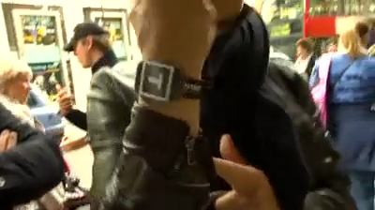
Notes:
2011
Tissot Watch

Slide 23
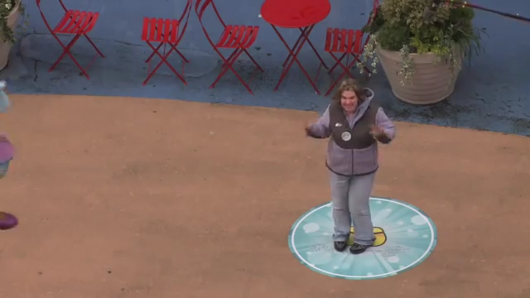
Notes:
2011
Disney
Times Square

Slide 24
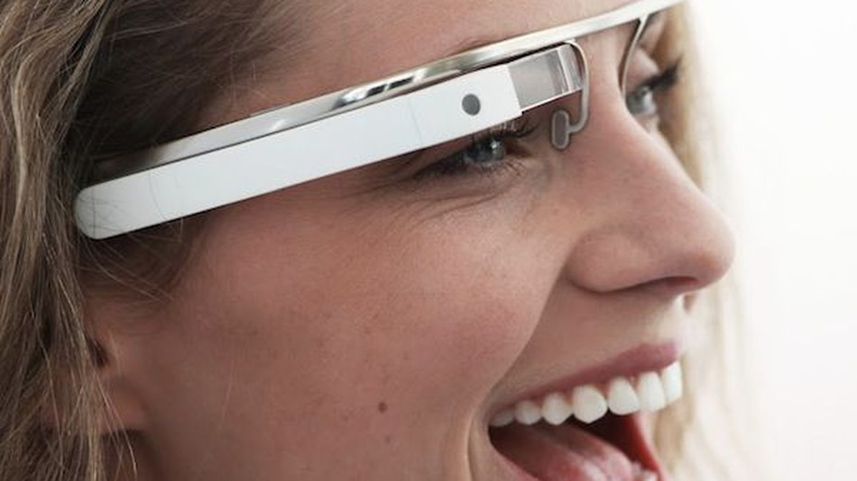
Source: http://mashable.com/2012/04/04/google-glasses-project-glass/
Notes:
2012
$1,500

Slide 25
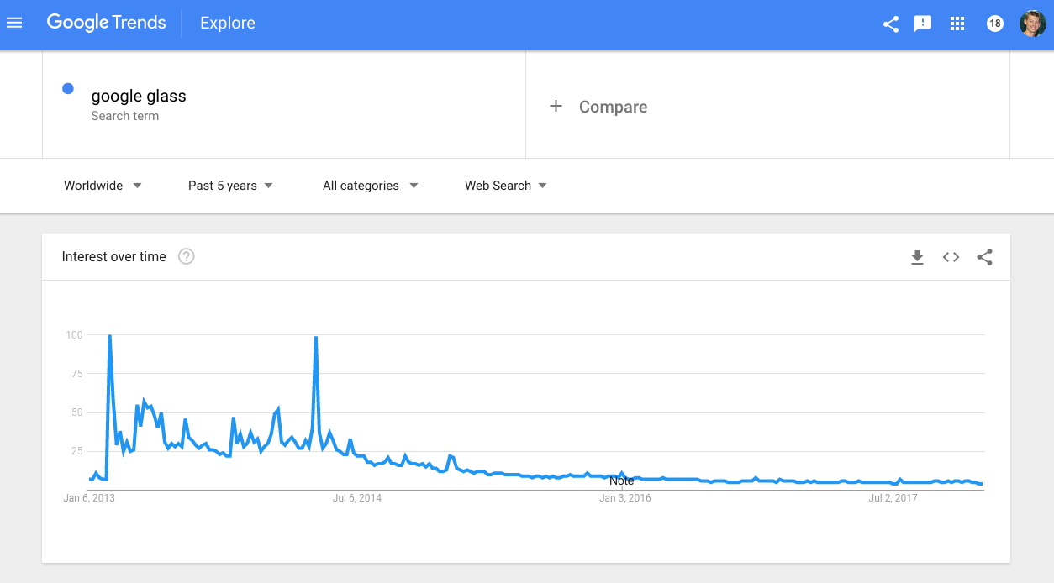

Slide 26
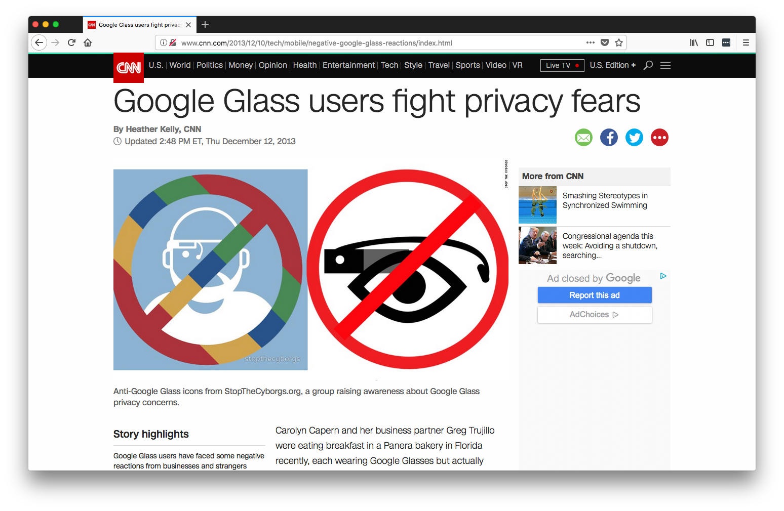

Slide 27
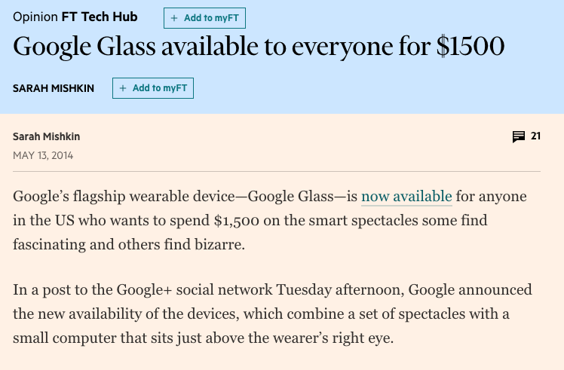

Slide 28


Slide 29
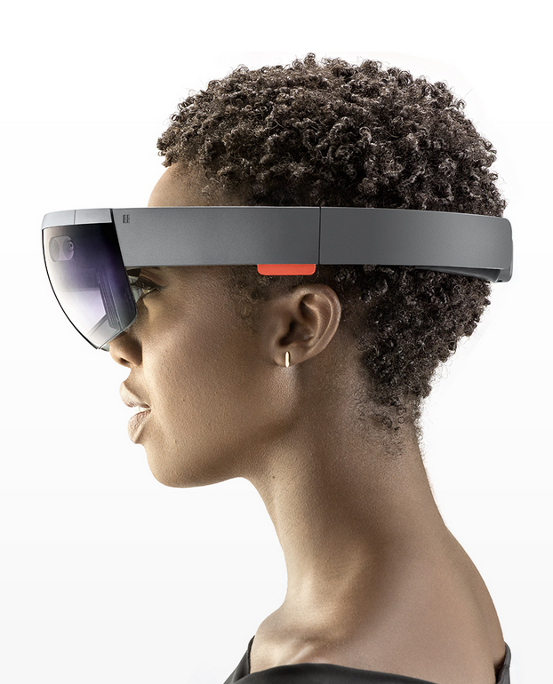
Notes:
2015

Slide 30
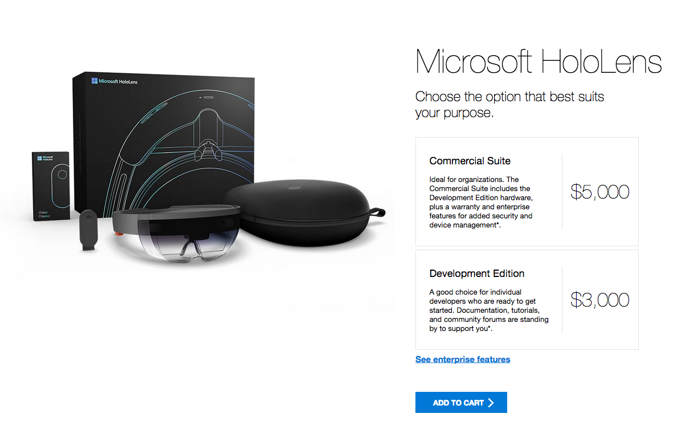

Slide 31
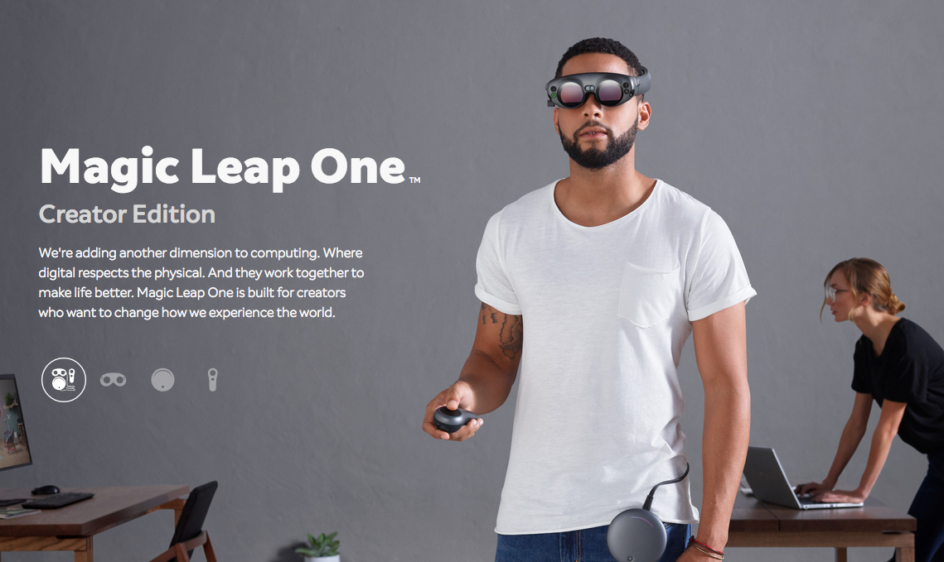
Notes:
Lightwear, Lightpack
Raised ~$2 billion to date

Slide 32
Agenda
Brief history of AR
AR today
Building AR apps w/JS

Slide 33
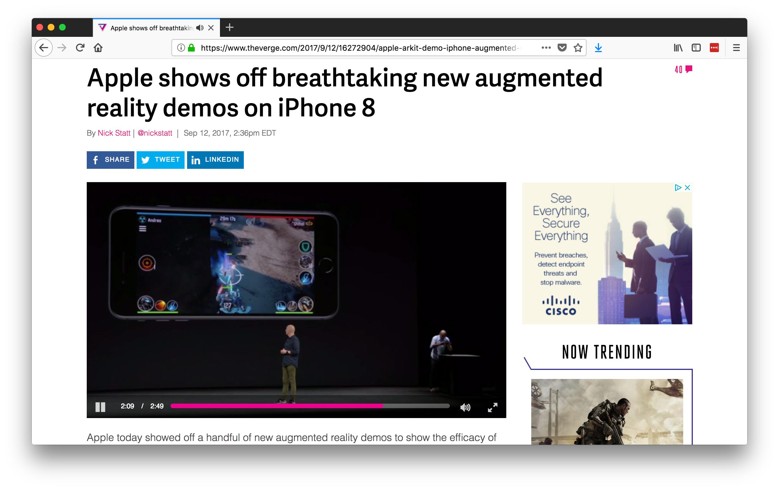
Notes:
ARKit shipped with iOS 11

Slide 34
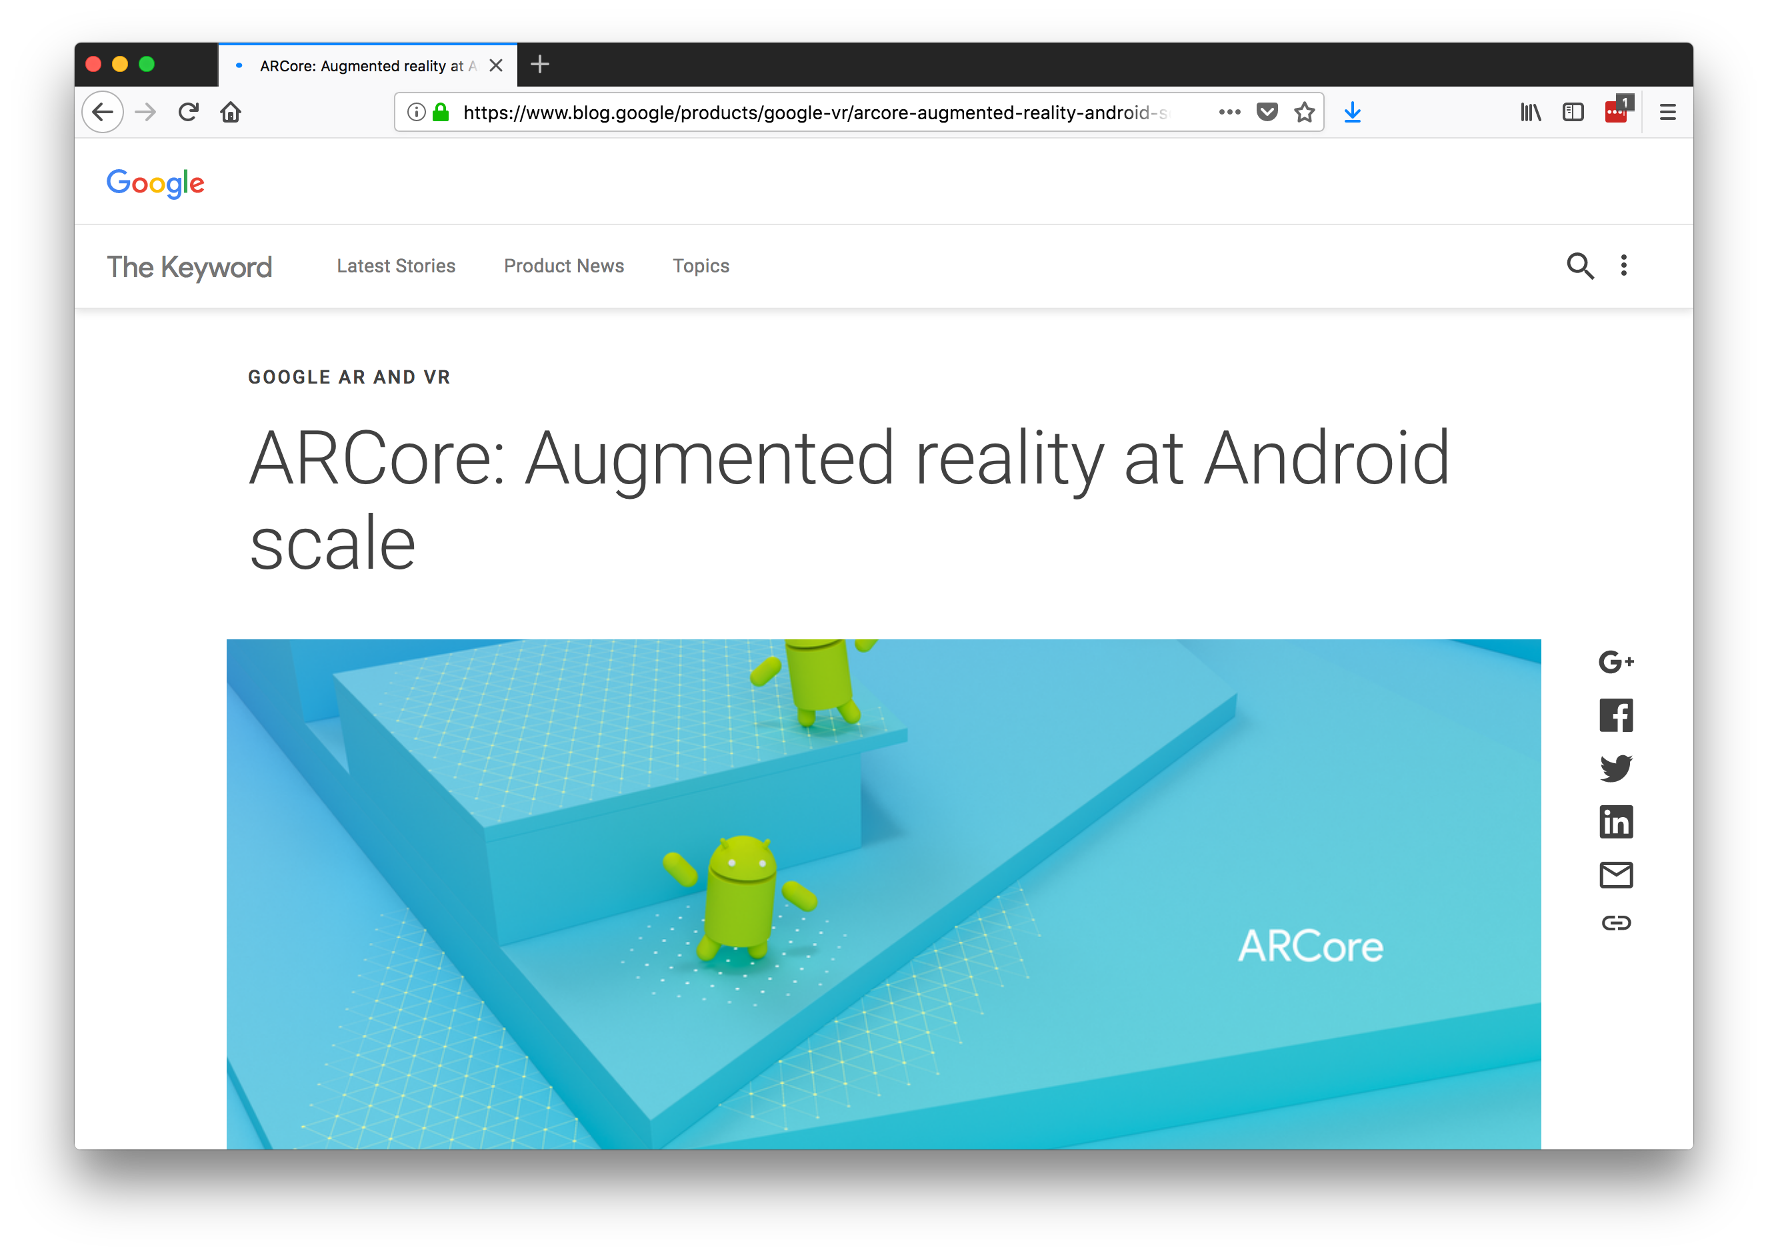
Notes:
August 2017
Today is still in a “developer preview”

Slide 35
Device Support
ARKit
iPhone 6S+
iPad Pros and Generation 5 regular iPads
ARCore
Pixel, Pixel XL, Pixel 2, Pixel 2 XL
Galaxy S8, S8+, Note8, S7 and S7 edge
LGE’s V30, V30+ (Android O only)
ASUS Zenfone AR
OnePlus’s OnePlus 5
Notes:
iOS limitation—A9 chip

Slide 36
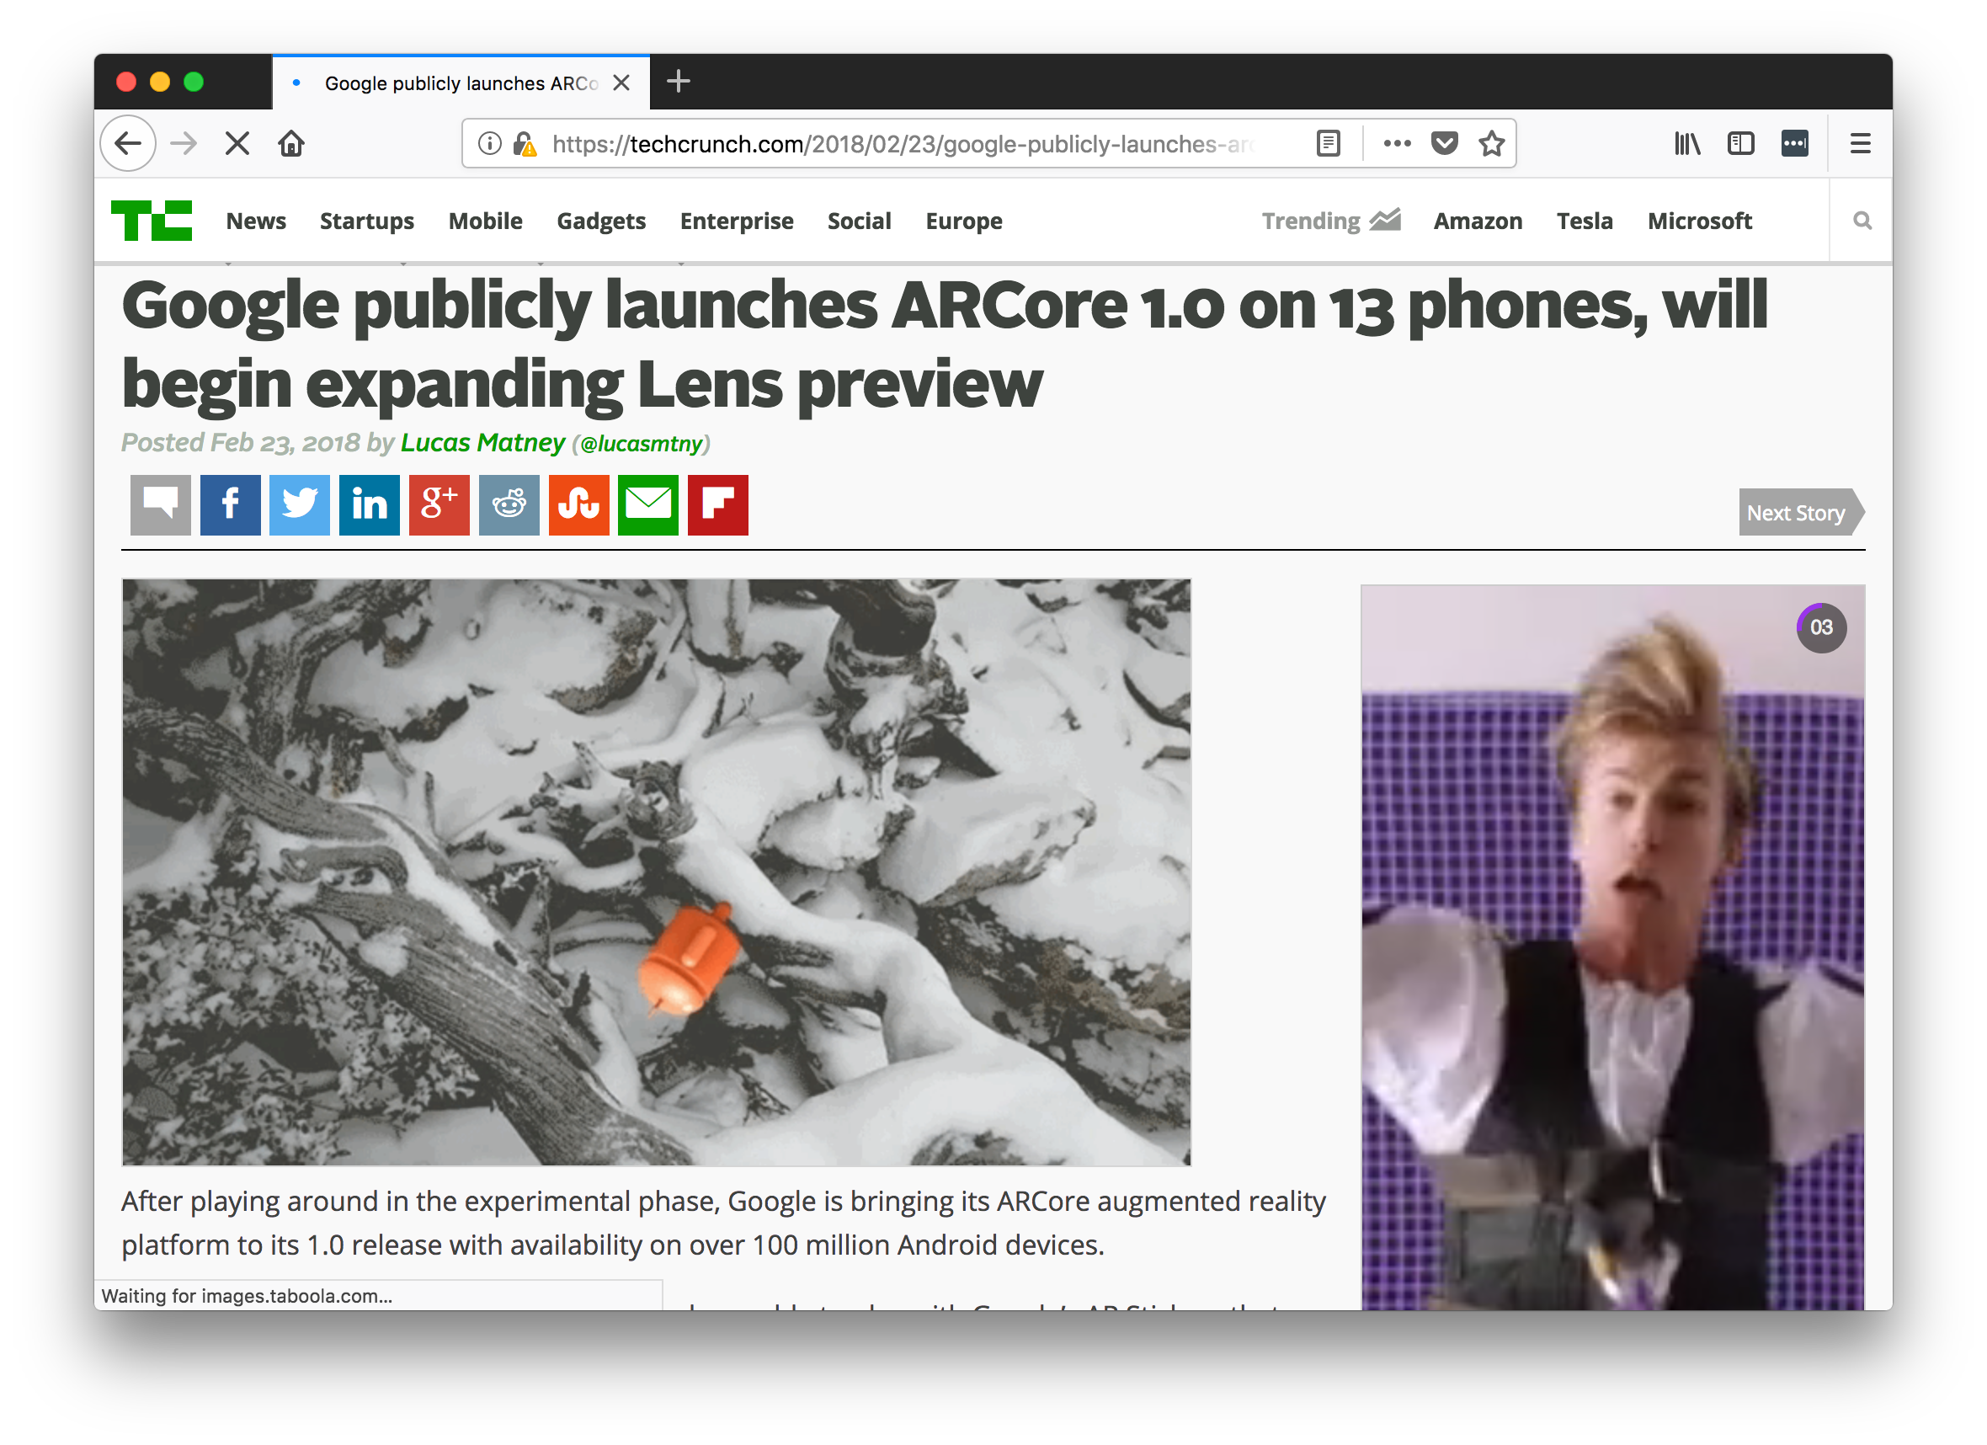

Slide 37
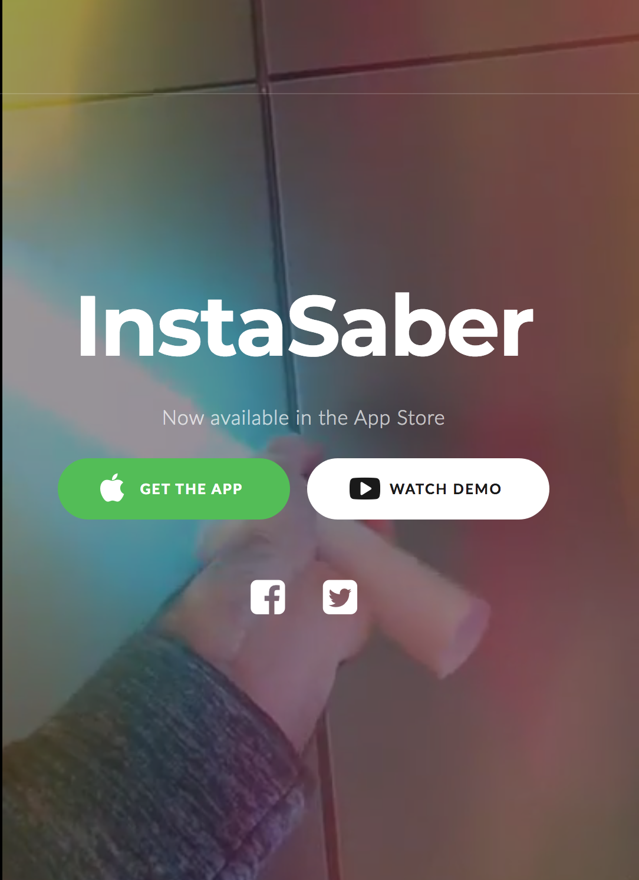
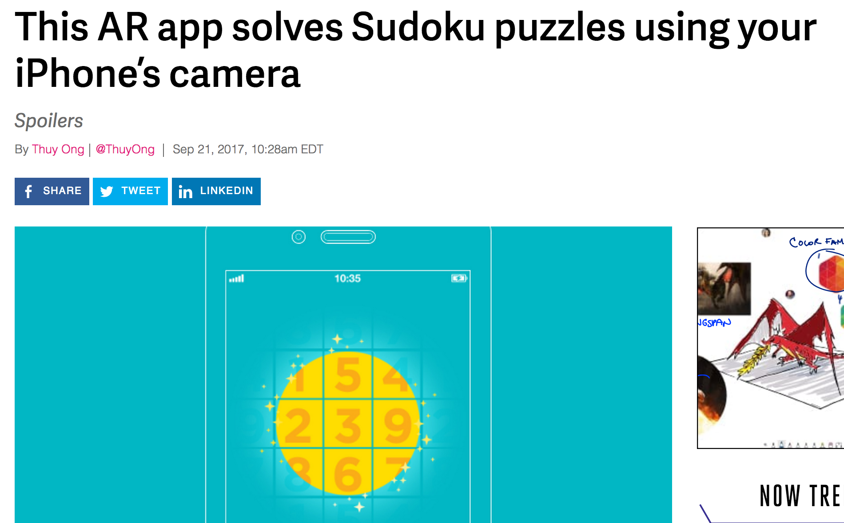
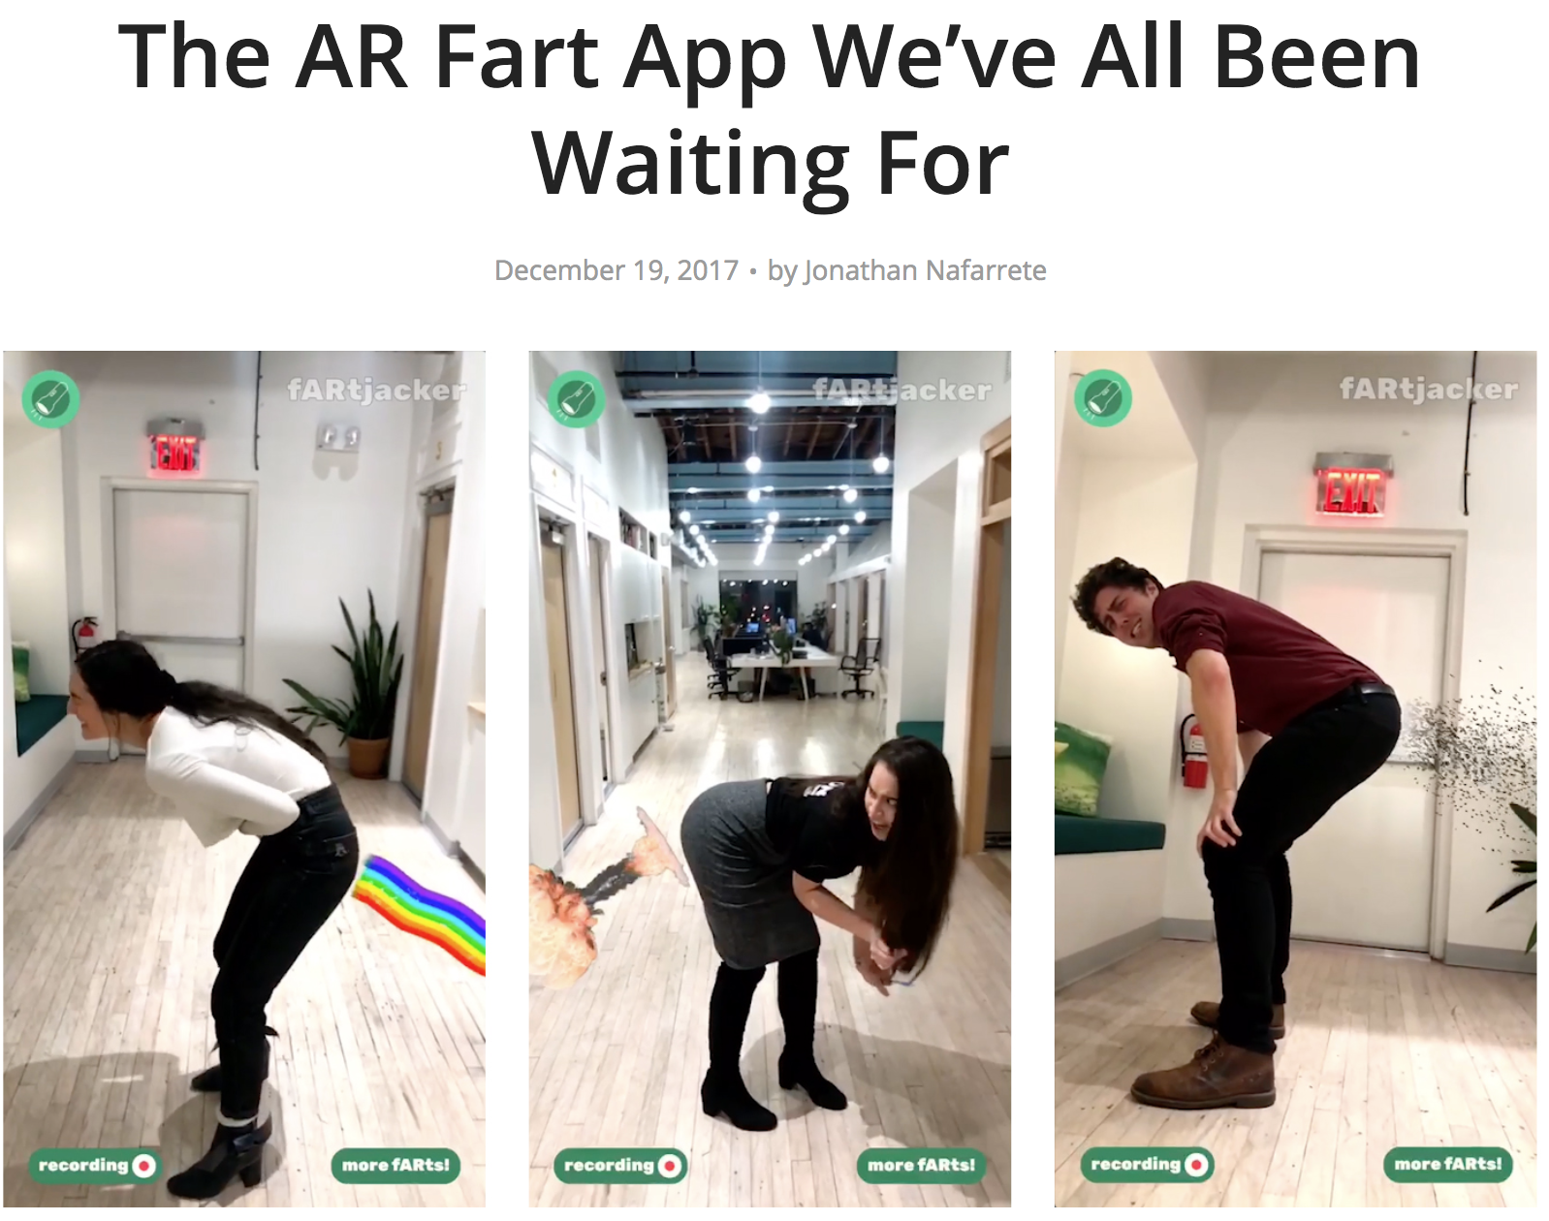

Slide 38
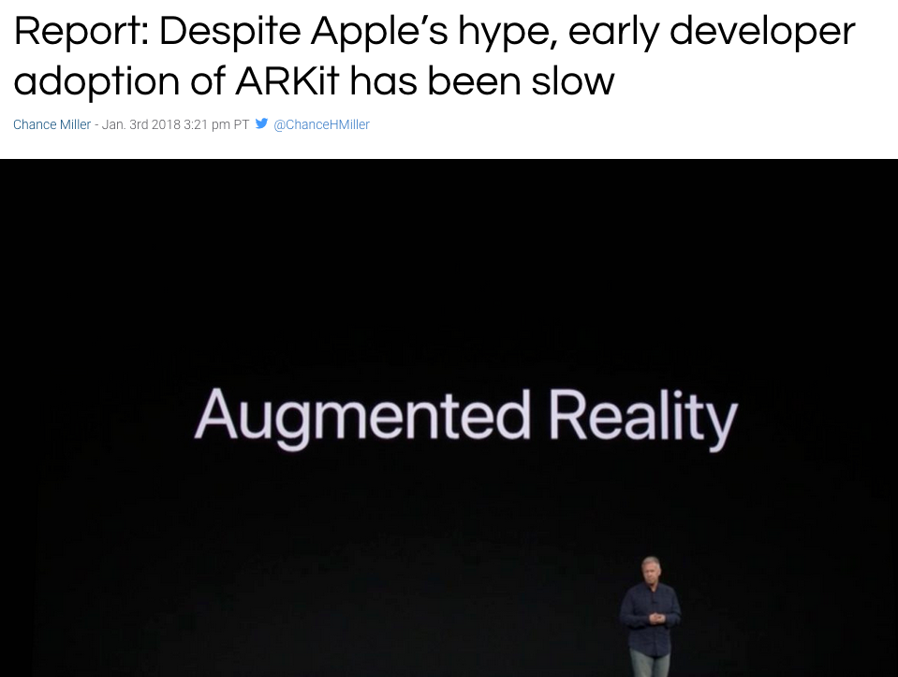

Slide 39
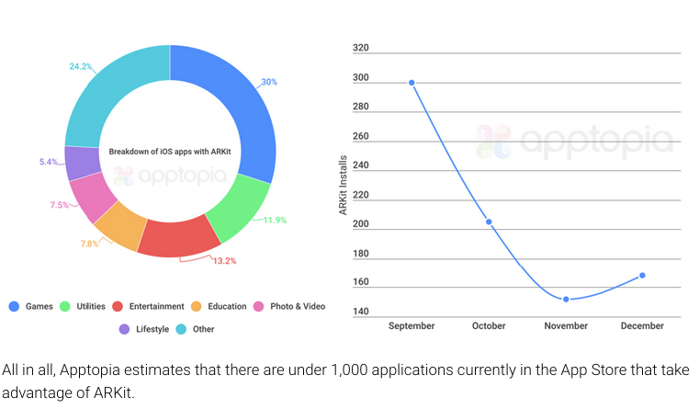

Slide 40
Agenda
Brief history of AR
AR today
Building AR apps w/JS

Slide 41


Slide 42


Slide 43
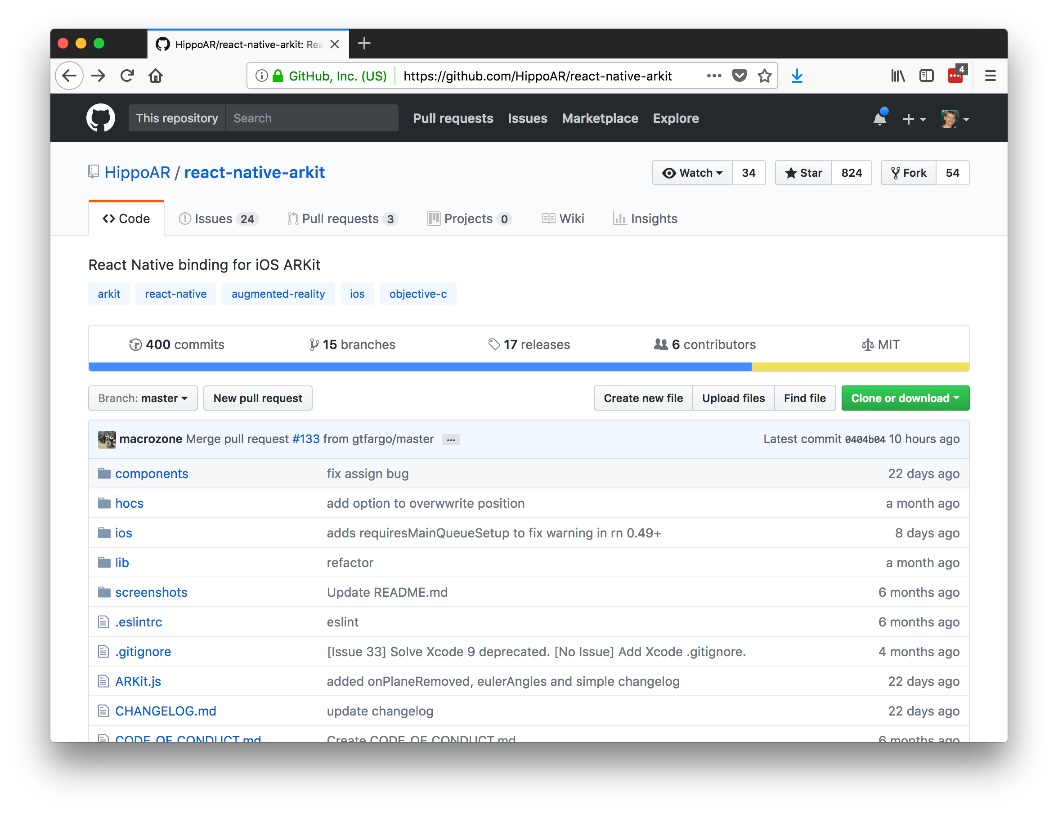

Slide 44
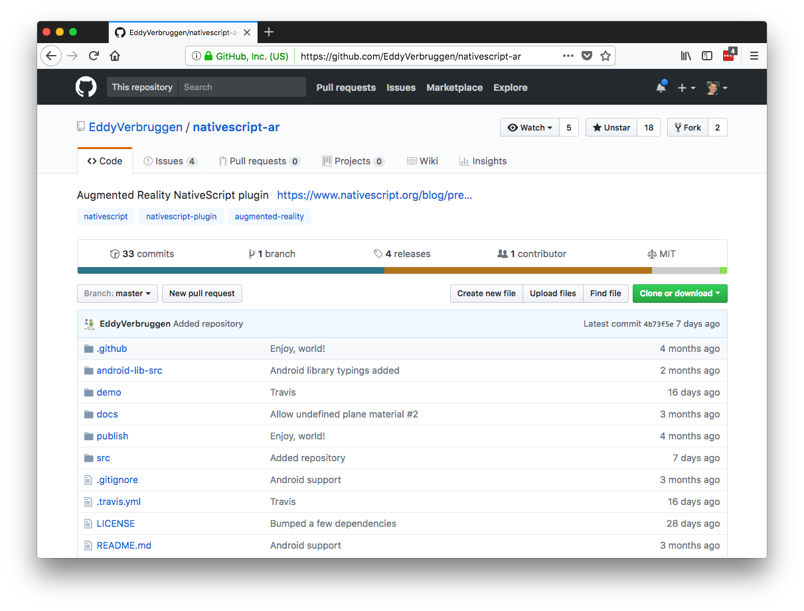

Slide 45
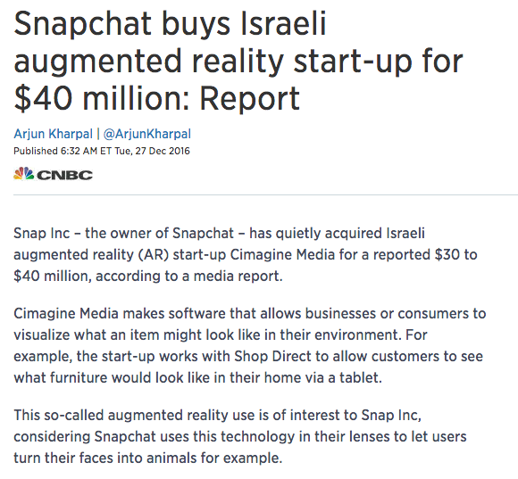
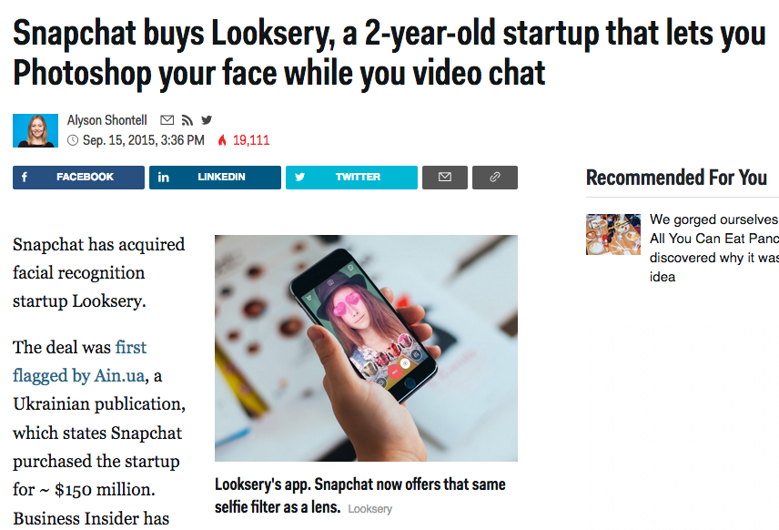

Slide 46
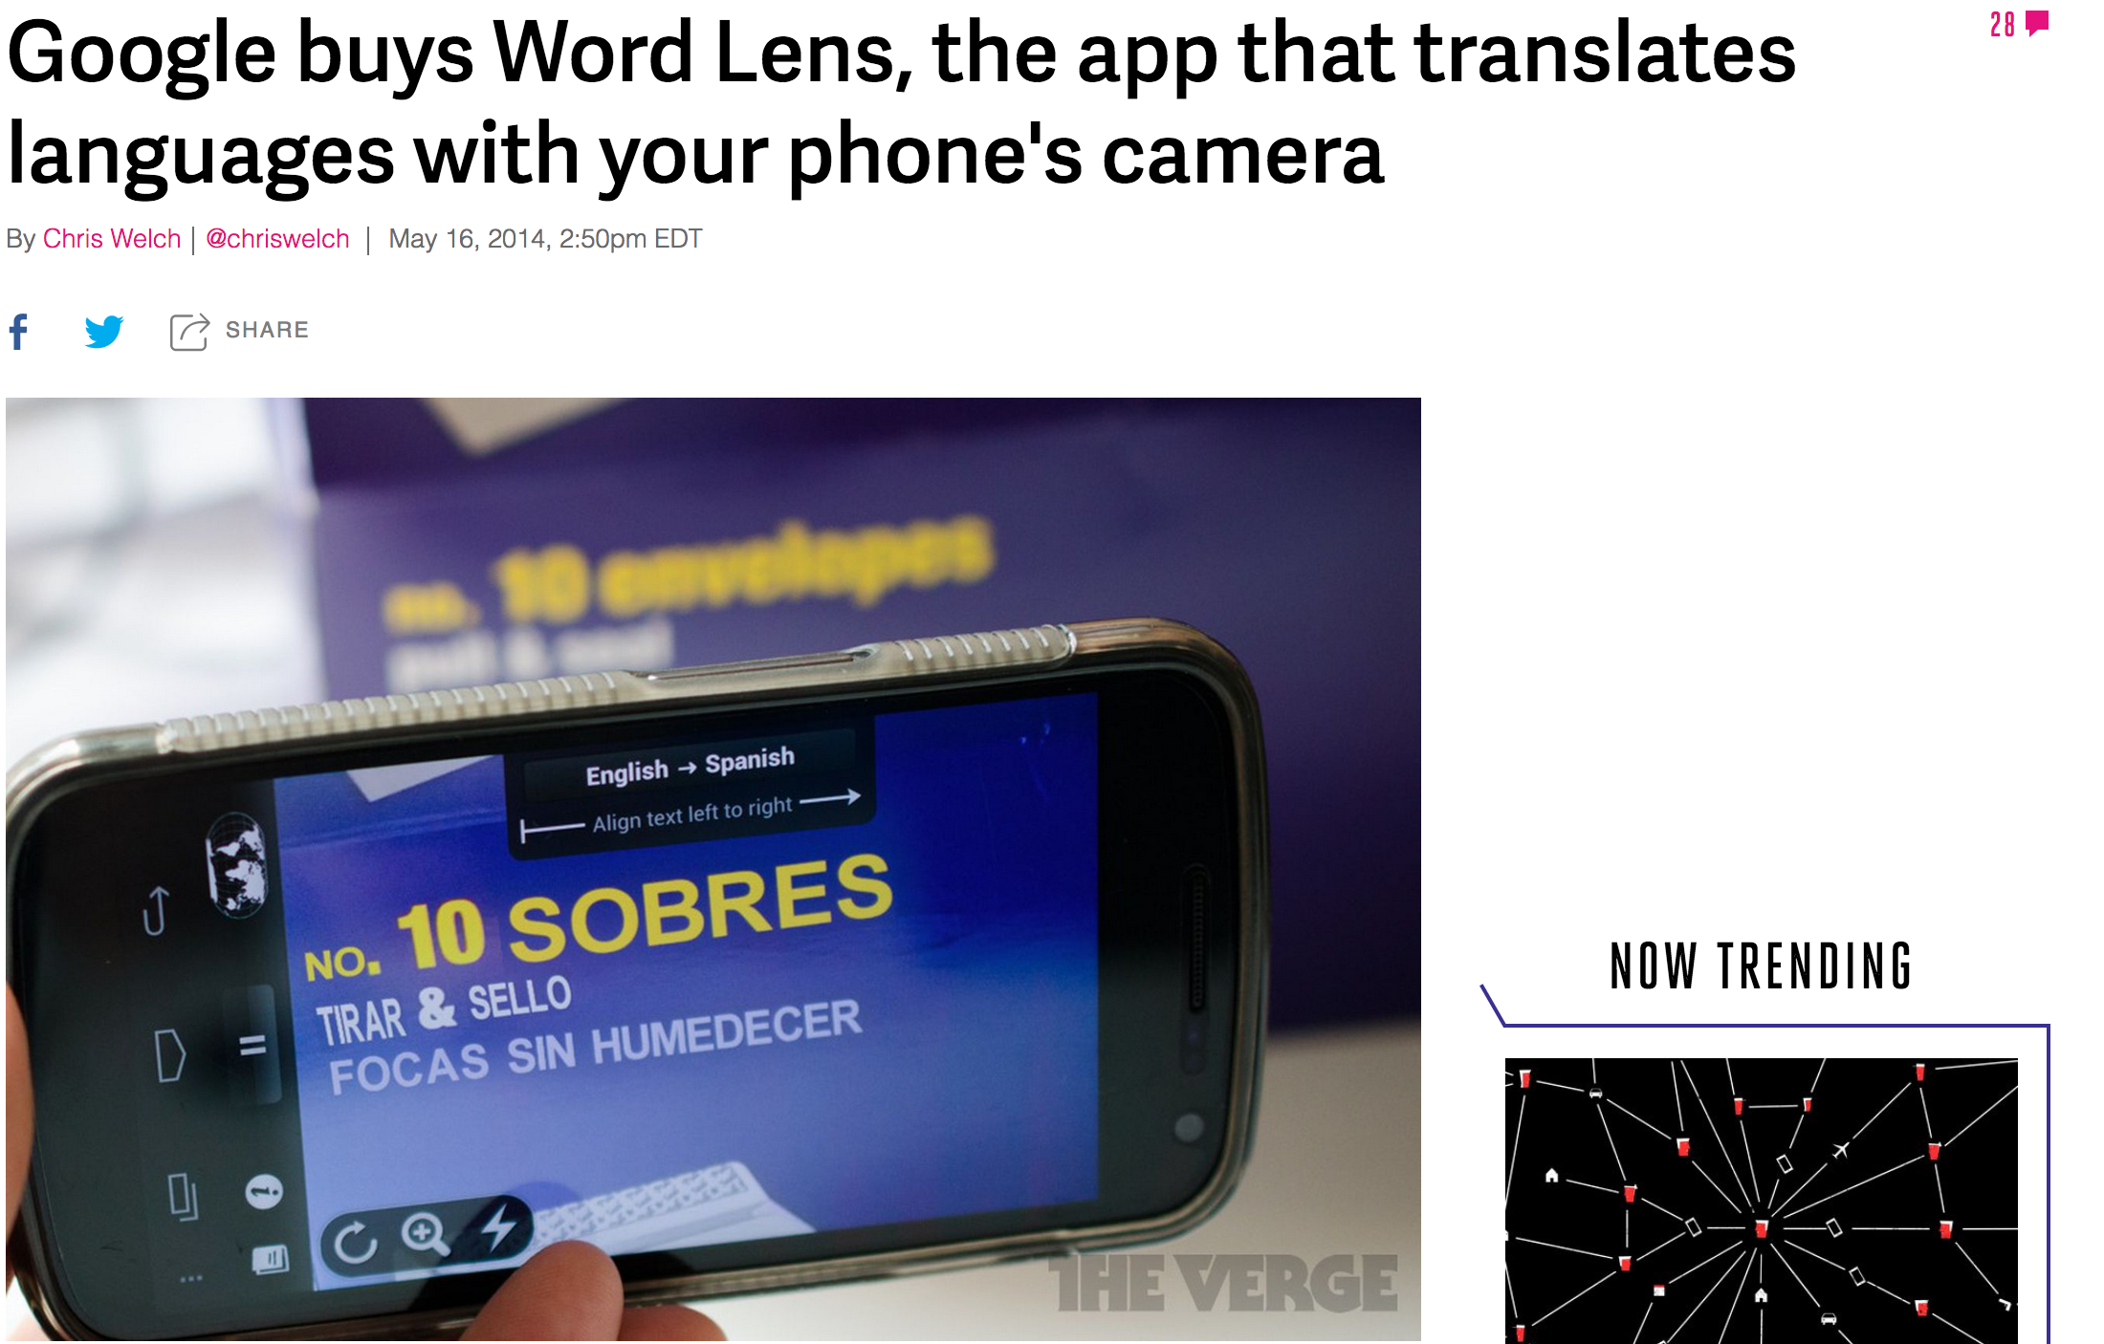

Slide 47
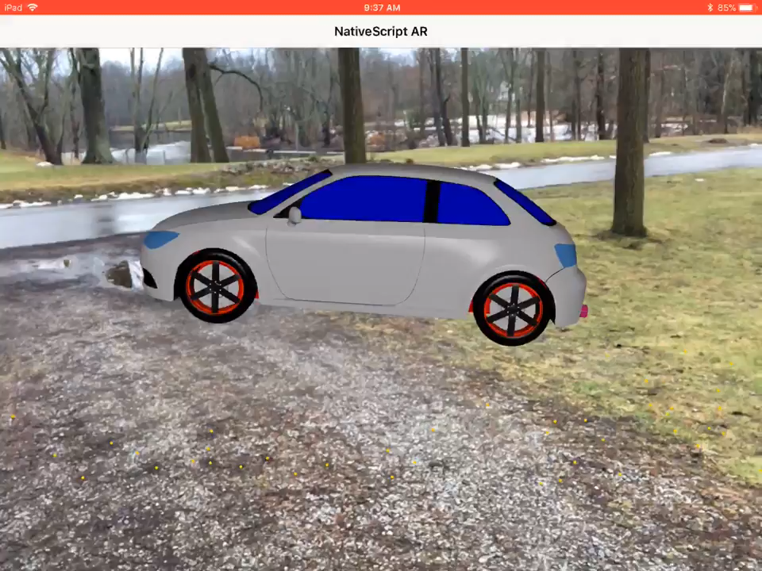

Slide 48
Summary
AR is cool.
AR is hard.
It’s probably a few years before AR is simple enough for your average developer to build something compelling with.

Slide 49
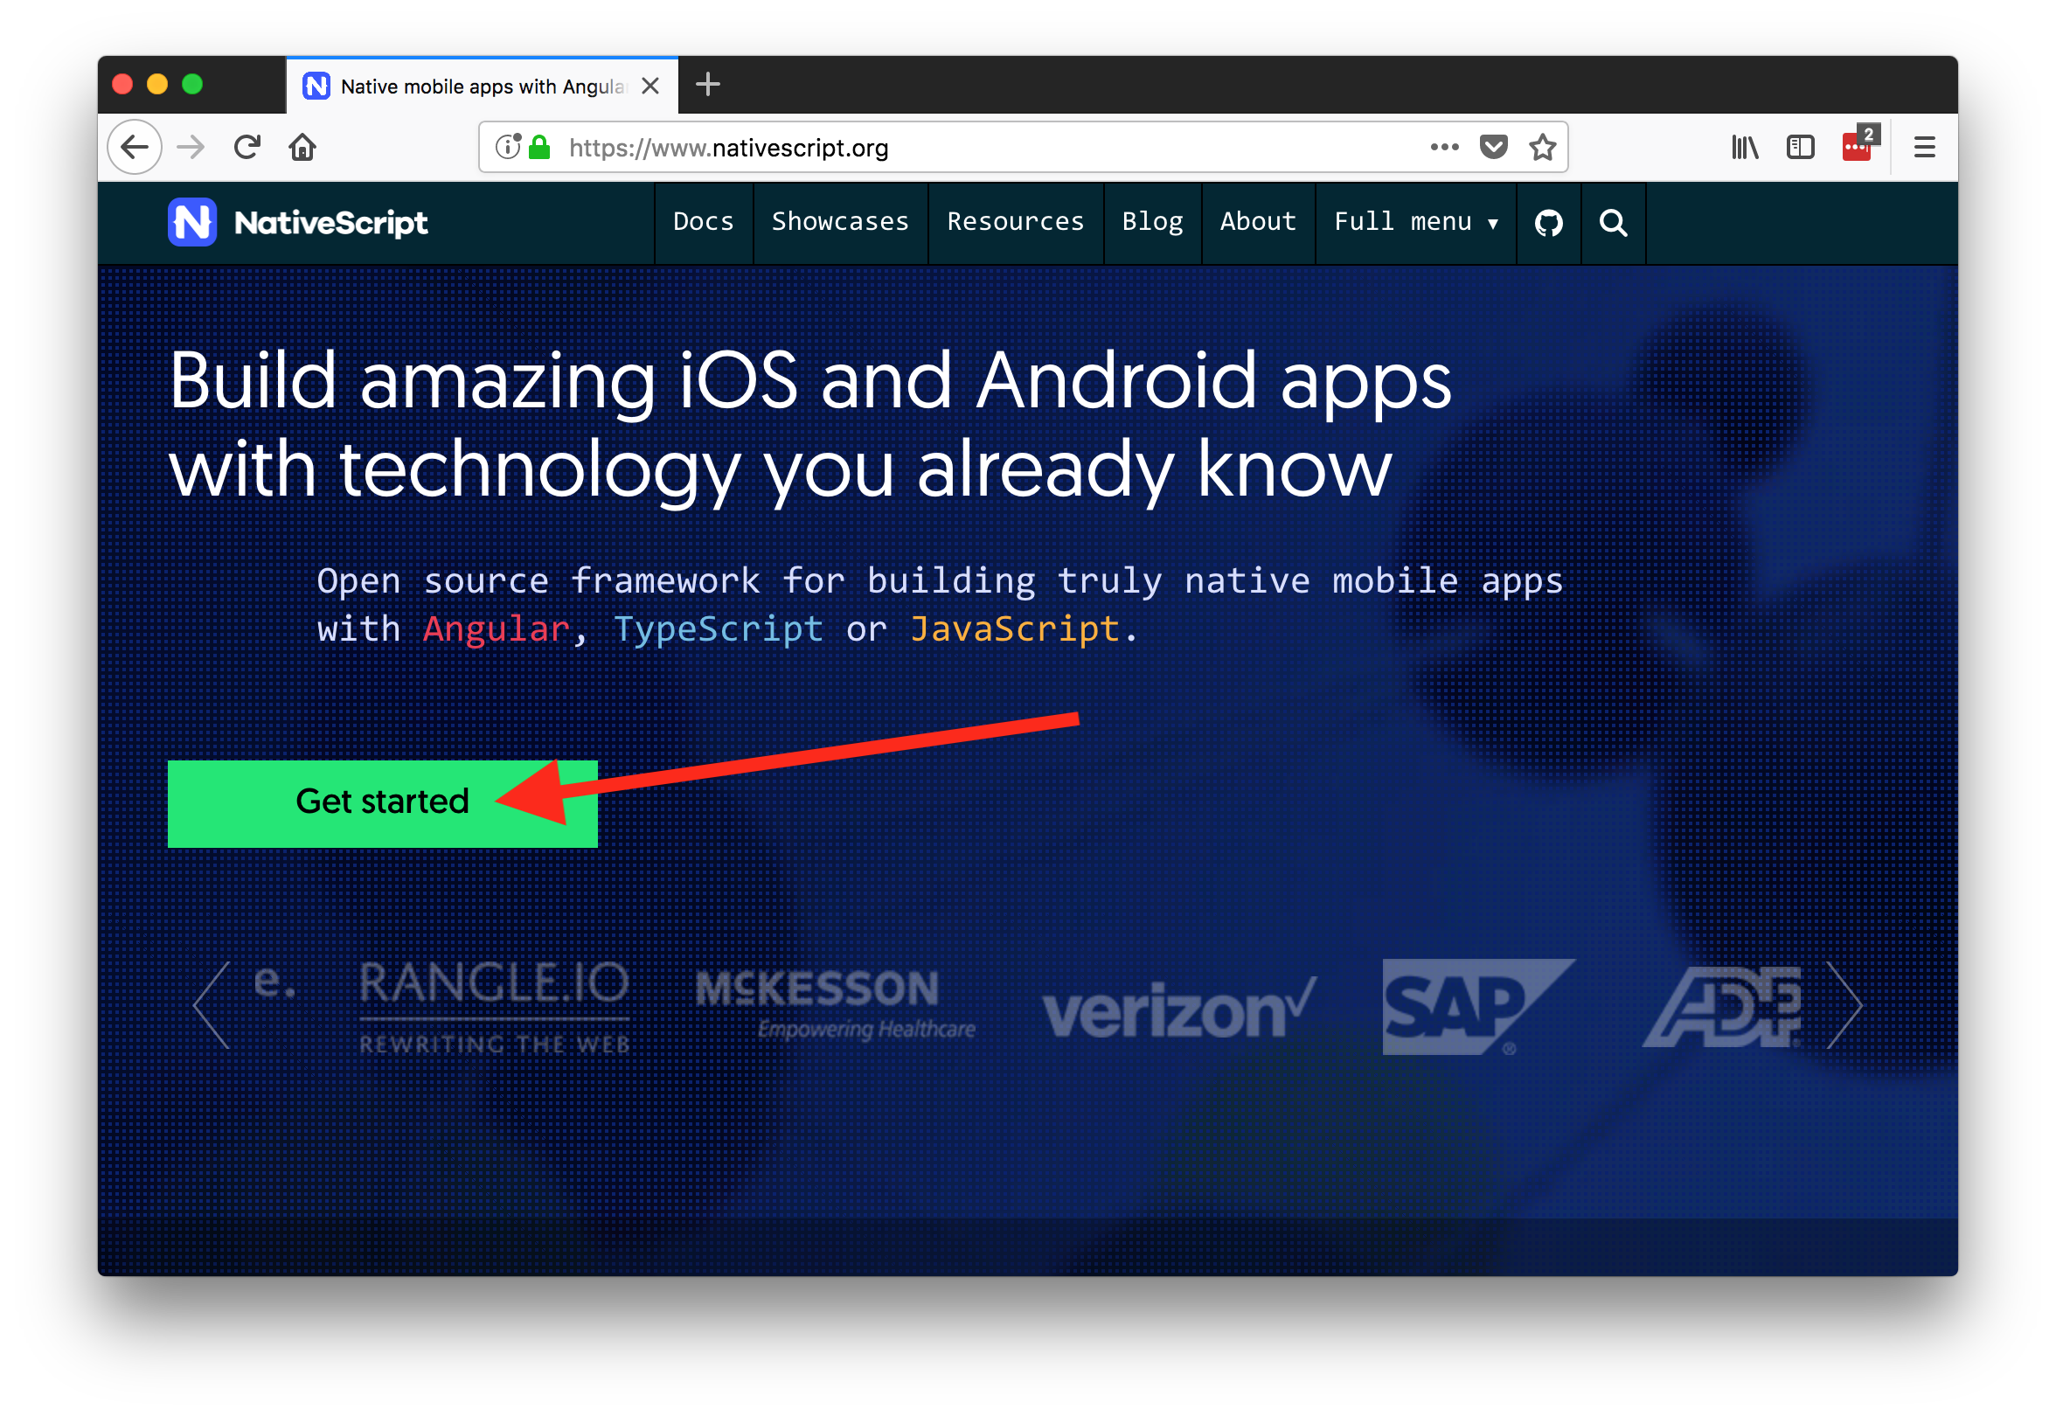

Slide 50

Thanks! 😊
@tjvantoll

